Slide 1
OpenFPM:
Microscope Assembly Instructions
- Lewis Walker
- University of Strathclyde, Glasgow, Scotland
- Last Edited: 30th October 2026

Slide 2
Prerequisites
We strongly suggest following and checking OpenFlexure for updates on the OpenFlexure Bill of Materials, OpenFlexure Print the plastic parts and the OpenFlexure instructions.
Listed below are the steps we followed to start building the microscope assembly:
Configure and test your printer – All steps
Prepare the main body – Steps 1, 4 and 5
Prepare the microscope stand – All steps
Assemble the actuators – All steps
Assemble the high-resolution optics module – Steps 1, 5 and 6
  Note. OpenFPM is a finite conjugate imaging system. Therefore, we do not use an achromatic/tube lens. Additionally, a monochromatic camera is used instead of a Raspberry Pi colour camera. Monochromatic cameras are generally preferred in FPM for various reasons, some including; higher quantum efficiency (better darkfield signal and reduced exposure times) and easier collection of the coherent passband for each image/LED (visualised in Fourier space by taking the Fast Fourier Transform (FFT) of the image, this can be completed using FIJI/ImageJ, MATLAB or python, etc.).
Mount the optics and the microscope – Steps 1 and 2 (More details provided later)
Assemble the motors – All steps

Slide 3
Components I
Here we provide a list of the components (and their quantity) required to assemble the microscope:
3D Printed Components (Custom):
C mount mirror cover (x1)
Camera adapter (x1)
Objective lens holder (x1)
OpenFlexure stand with mirror holder (x1)
3D Printed Components (OpenFlexure):
OpenFlexure actuator assembly tools (x1)
OpenFlexure cable tidies (x1)
OpenFlexure feet (x1)
OpenFlexure large gears (x1)
OpenFlexure main body (x1)
OpenFlexure small gears (x1)
Optical Components:
Objective lens (x1)
Mirror – 1 inch (x1)
Misc. Components:
Sharpie pen (blunt thin object)
Lens tissue paper
Methanol
Air duster
2.5 mm hex key tool

Slide 4
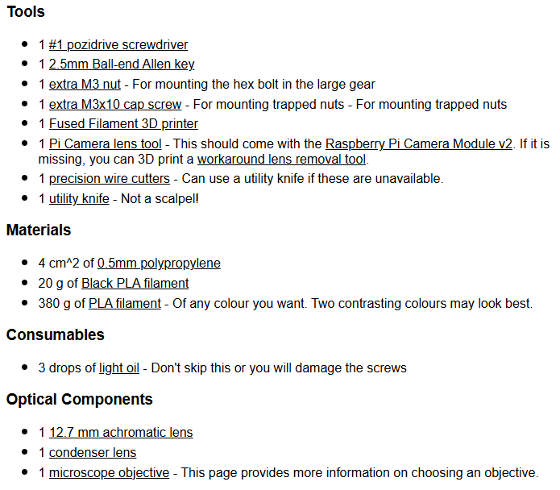
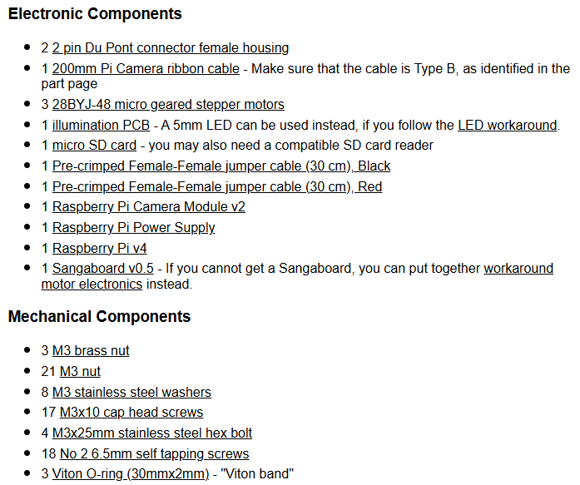
Components II
We also suggest revising the OpenFlexure Bill of Materials. Components listed here are required to build the OpenFlexure microscope prior to use as an OpenFPM system:
2-3 rolls of Black PLA filament should be plenty
Normally these can be bought in bulk from Amazon or an online/local hardware store. Best to have spares

Slide 5
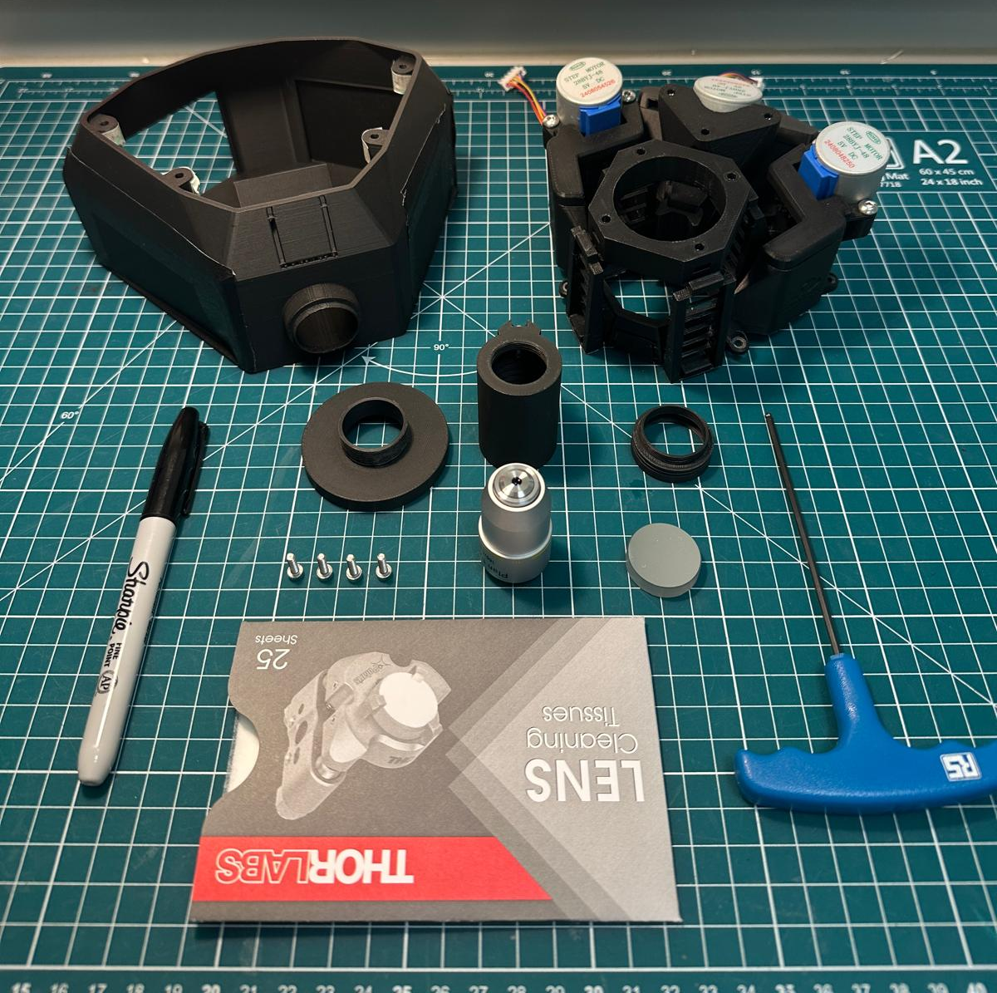
Parts I
OpenFlexure stand with mirror holder
Assembled OpenFlexure main body (prerequisite)
C mount mirror cover
Objective lens holder
Camera adapter
Sharpie
M3x10mm bolts (x4) – provided from OpenFlexure Bill of Materials
Objective lens (finite conjugate)
Mirror (1 inch)
2.5 mm hex key tool
Lens tissue paper

Slide 6
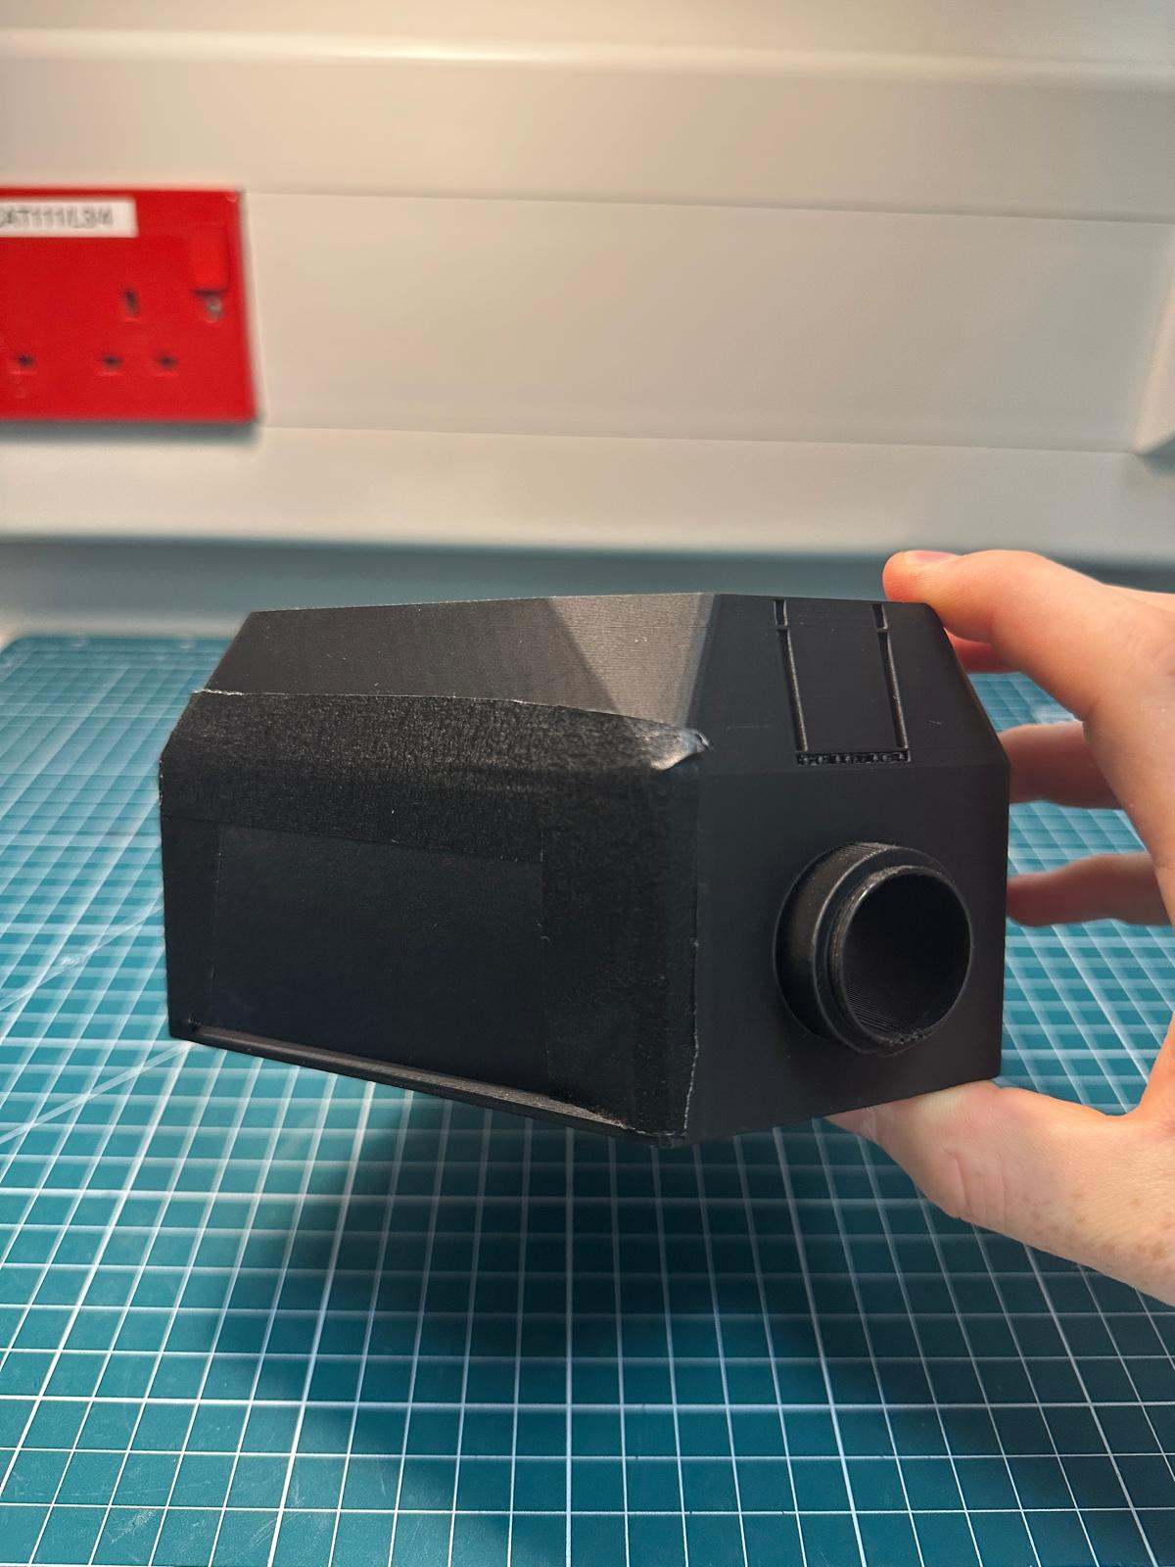
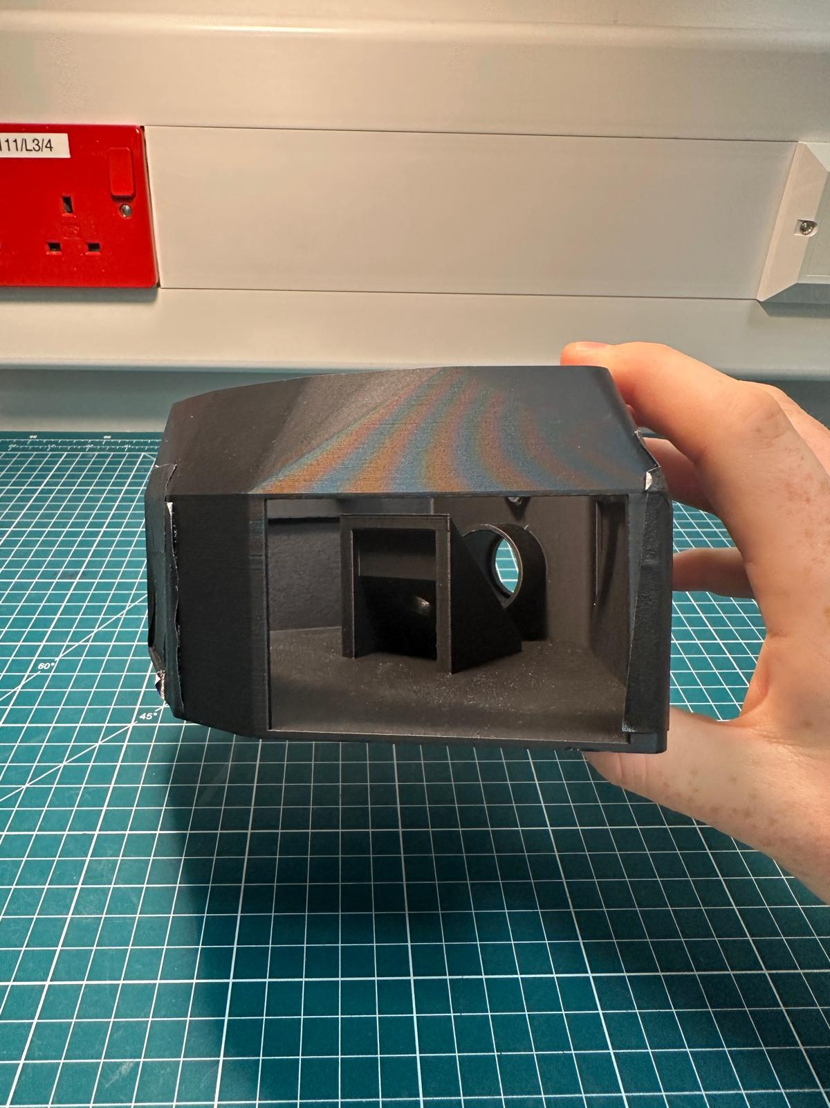
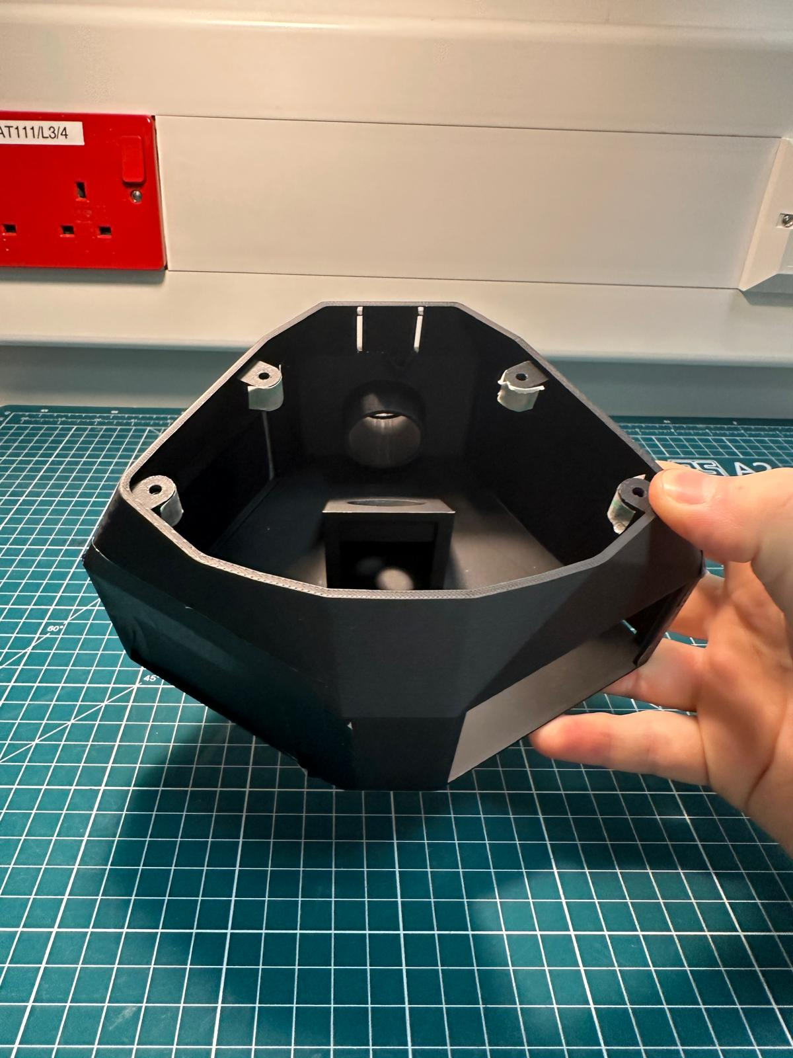
Parts II
Our adapted version of the OpenFlexure stand, comes with various windows, allowing the user access into the lower internals of the microscope.
For imaging we suggest closing these windows using a black material. Here we use black tape and thick black paper.
We leave one window open for electronic wires to pass through for the motors. This could be partially sealed with a cutout for the wiring to pass through, further limiting any external light.
Additionally, we use tape to ensure the four hex nuts don’t fall out when positioning the stand.
Windows blocked with black material/paper.
Back window left open for wires to pass through. This can be partially covered up once assembly and wiring is complete.
Tape put over hex nut hole inserts.

Slide 7
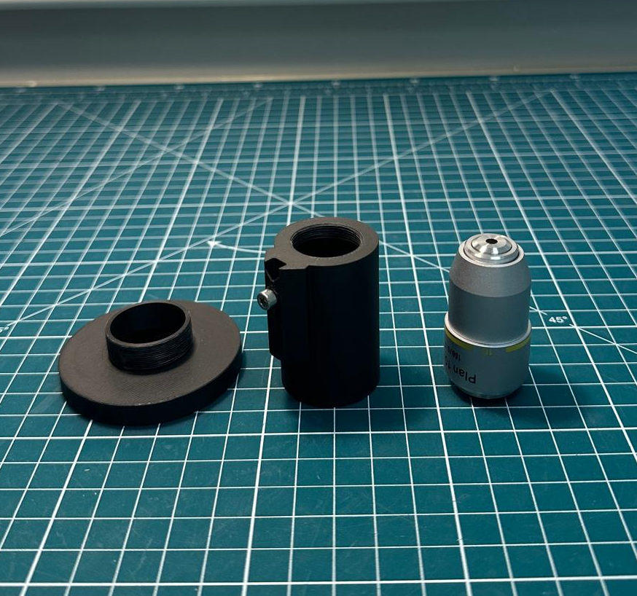
Step 1(a)
What you will need:
C mount mirror cover
Objective lens holder (nut and bolt connected from OpenFlexure instructions)
Objective lens

Slide 8
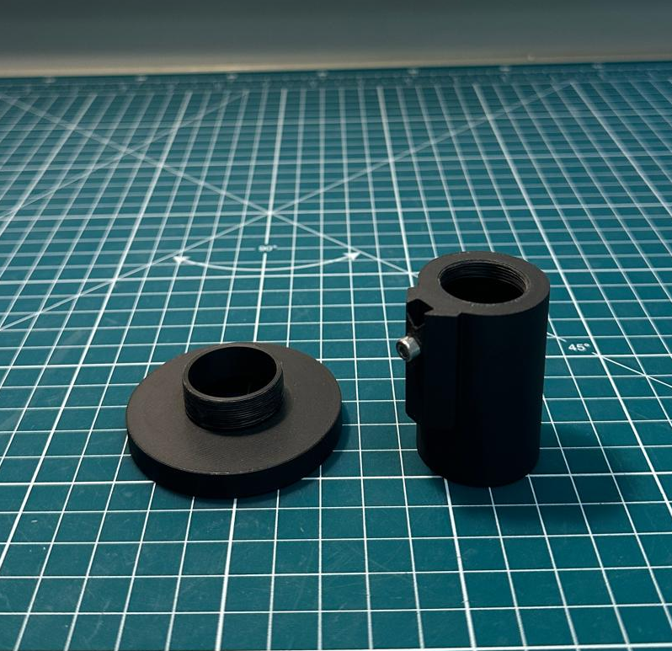
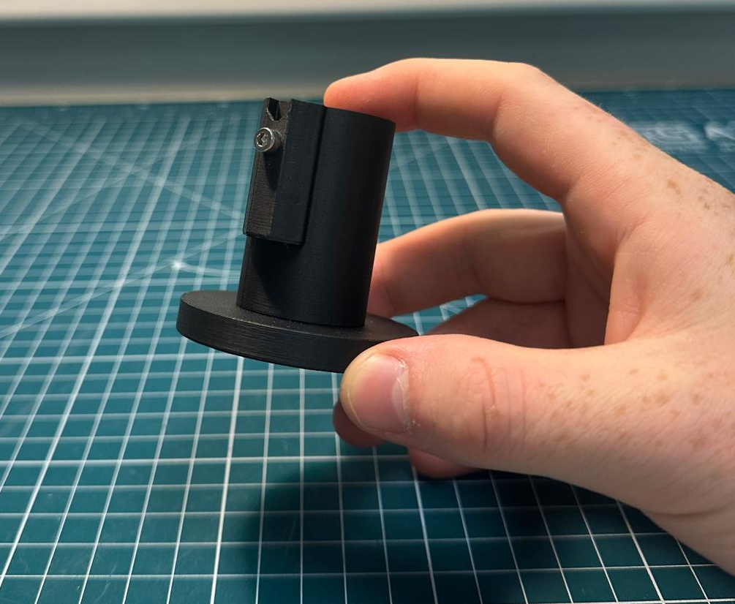
Step 1(b)
TODO:
Using the threading on each component, combine the two objects.
Tip:
We found newly printed components with threading can sometimes require a bit of back-and-forth movement to fully thread.
This will also depend on your printer resolution and settings.
We found the default settings on our Bambu labs printer to work well.

Slide 9
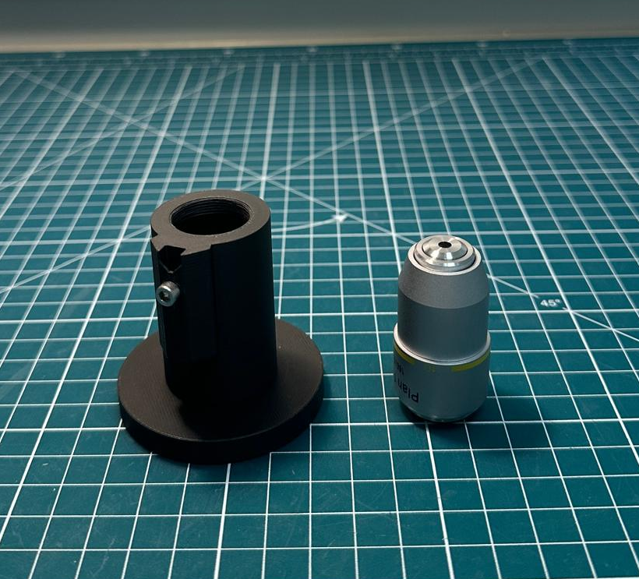
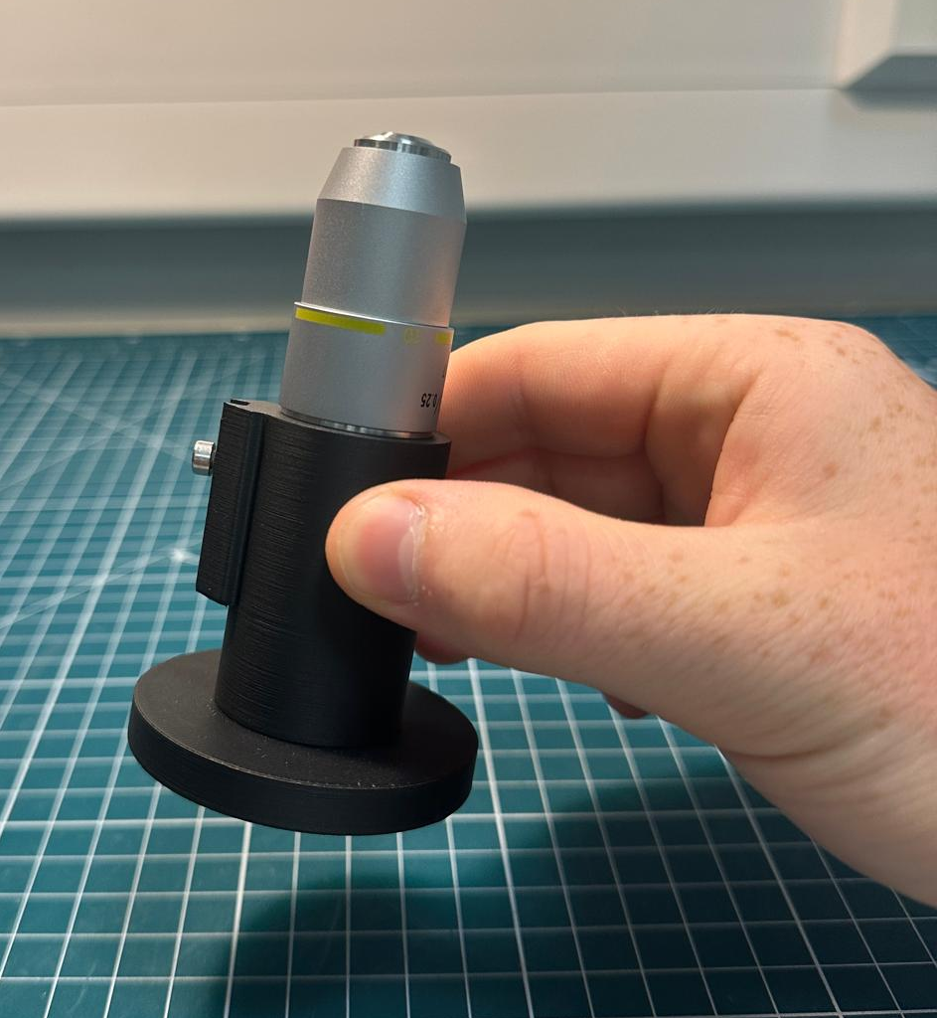
Step 1(c)
TODO:
Next, combine the objective lens using the threading at the top of the objective lens holder.

Slide 10
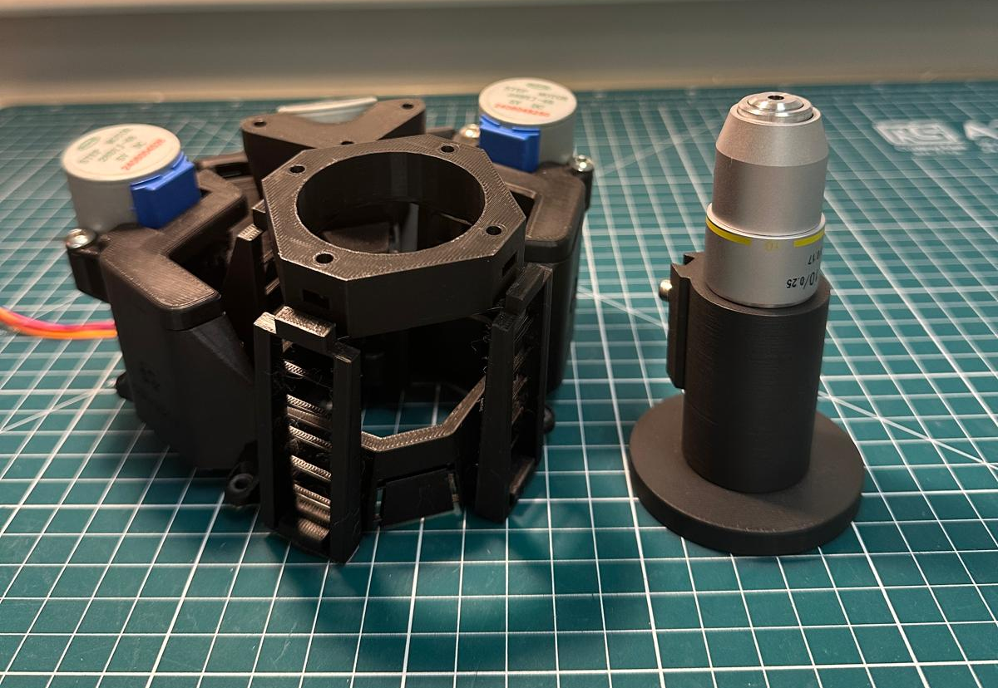
Step 2(a)
What you will need:
Objective lens assembly
OpenFlexure main body assembly

Slide 11
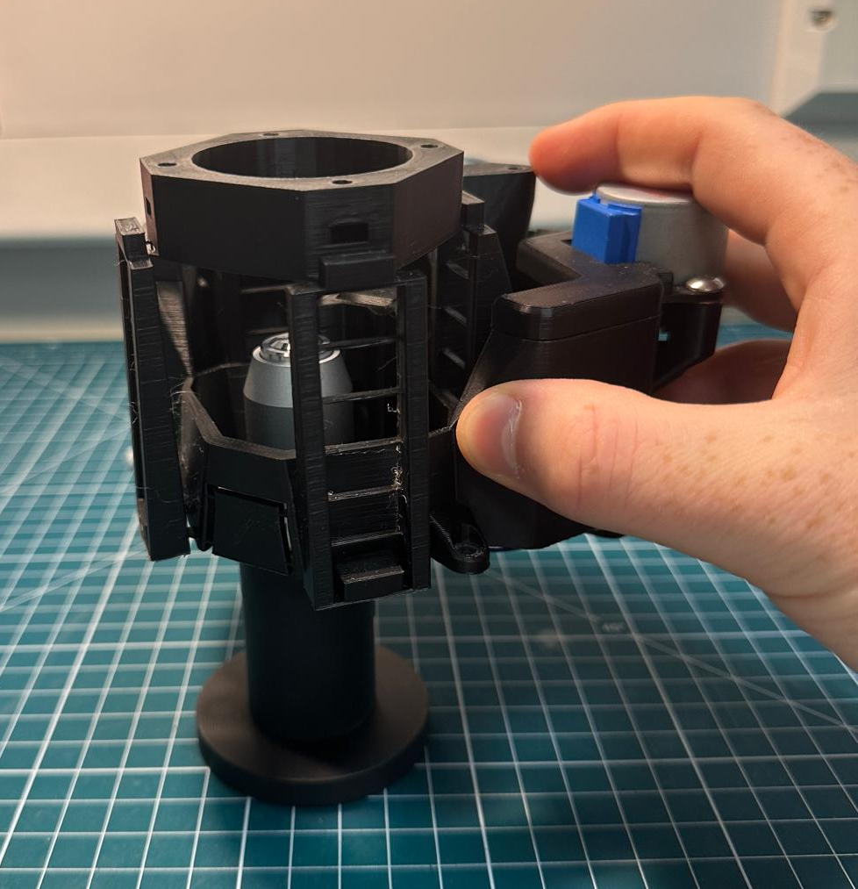
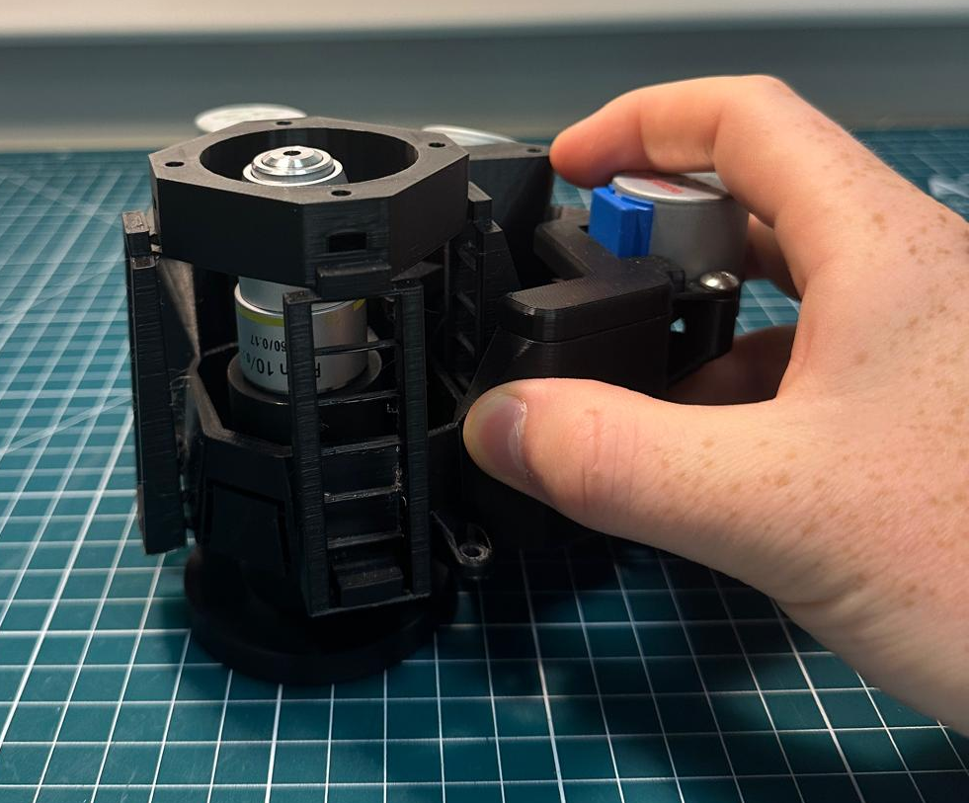
Step 2(b)
TODO:
Similarly to the OpenFlexure notes (Mount the optics and the microscope - Step 1), insert the objective lens component underneath and into the main body assembly.

Slide 12
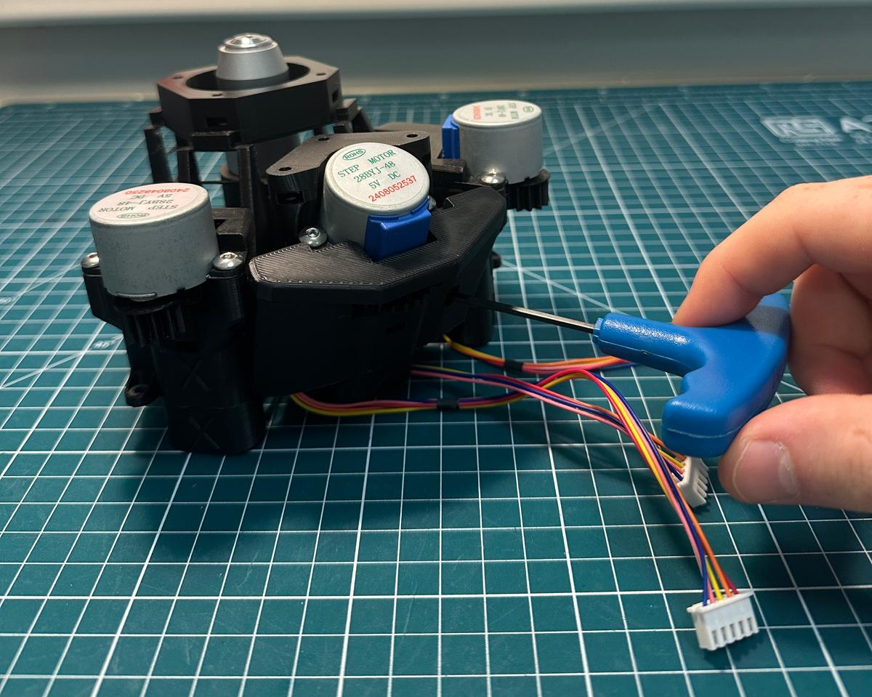
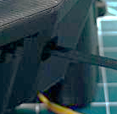
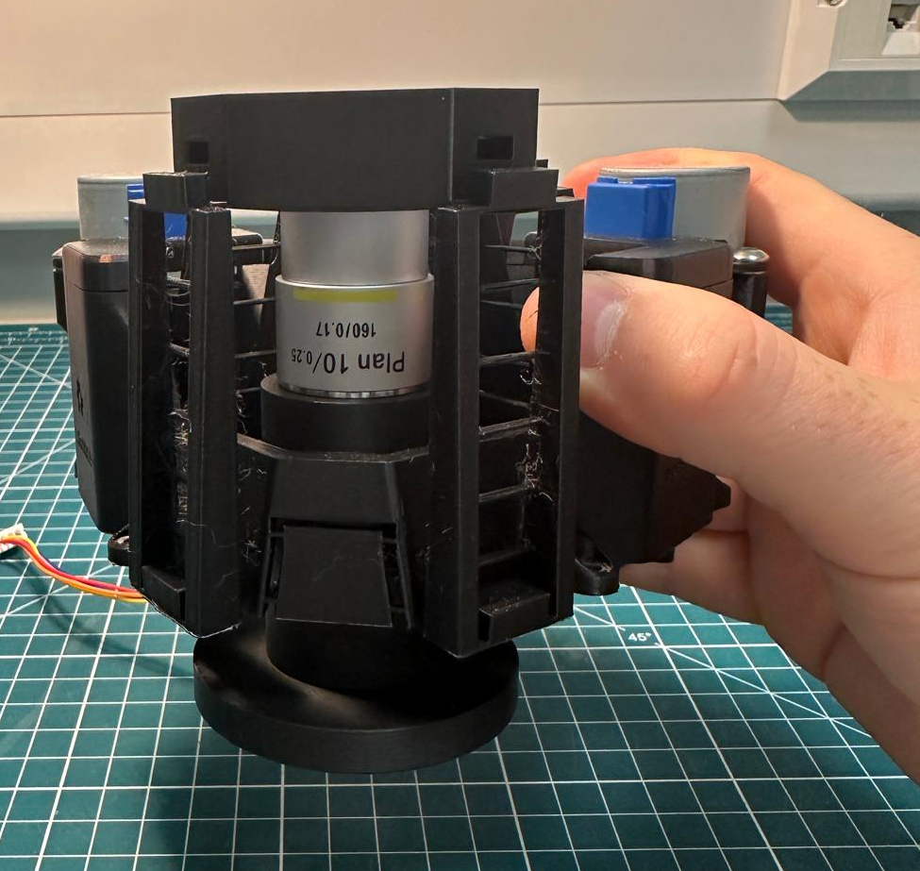
Step 2(c)
TODO:
Using the 2.5 mm hex key tool, loosen the bolt attached to the objective lens holder, through the hole in the back of the main body. Align and tighten it into position.
Once tightened, the objective lens components should stay in place when lifted, as seen in the lower image.

Slide 13
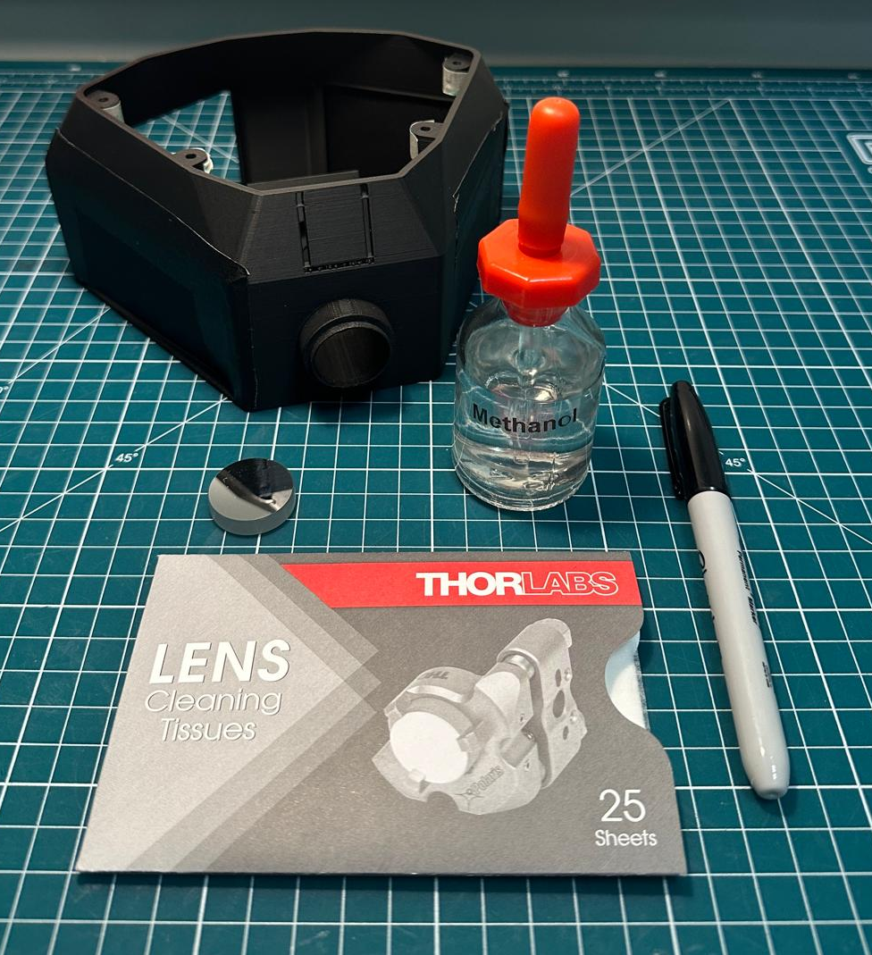
Step 3(a)
What you will need:
OpenFlexure stand with mirror holder
Mirror
Methanol
Lens tissue paper
Sharpie (blunt thin object)

Slide 14
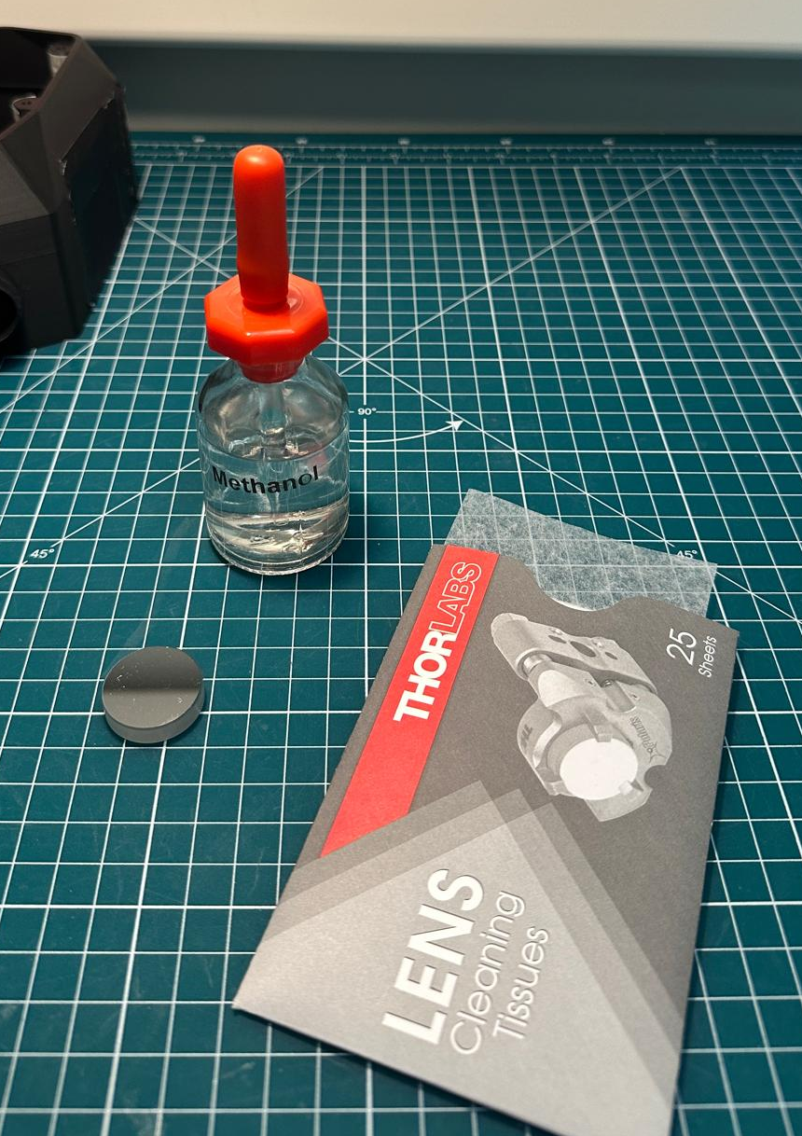
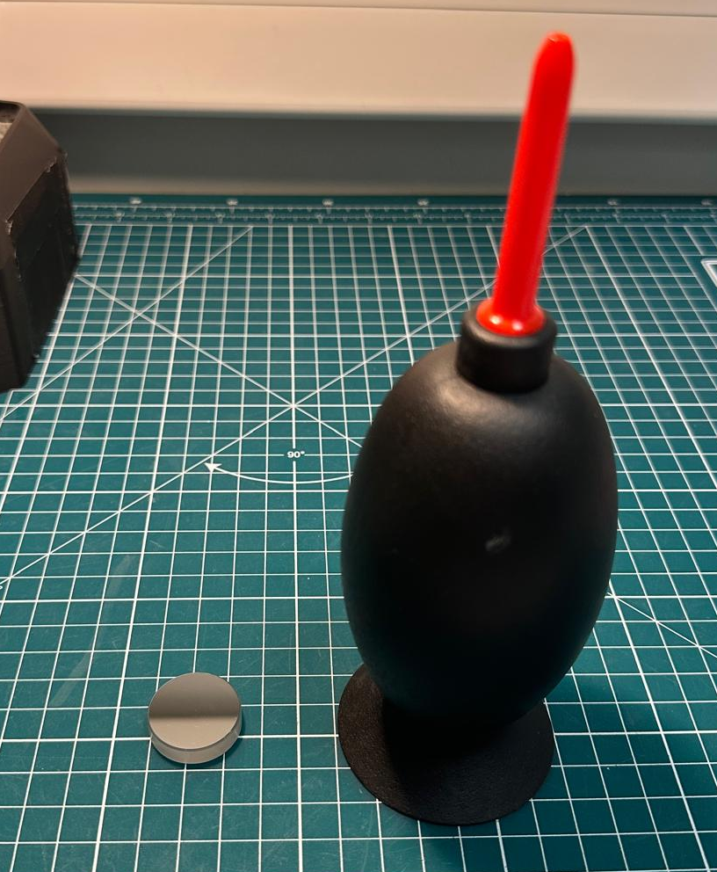
Step 3(b)
TODO:
Gently clean the mirror using a few drops of methanol on lens tissue.
Leave to evaporate.
Tip:
Use an air duster to help remove any remaining dust/droplets.

Slide 15
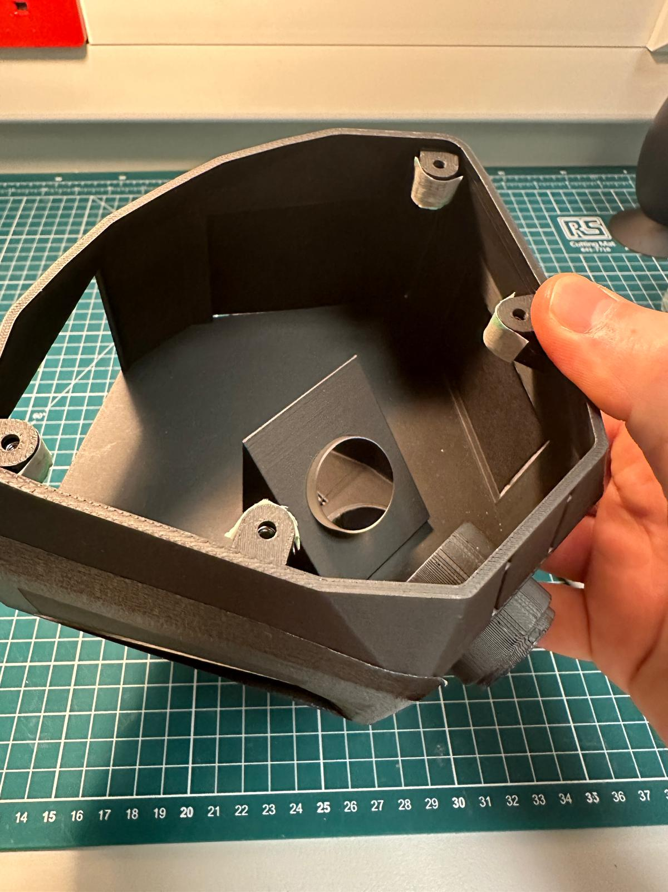
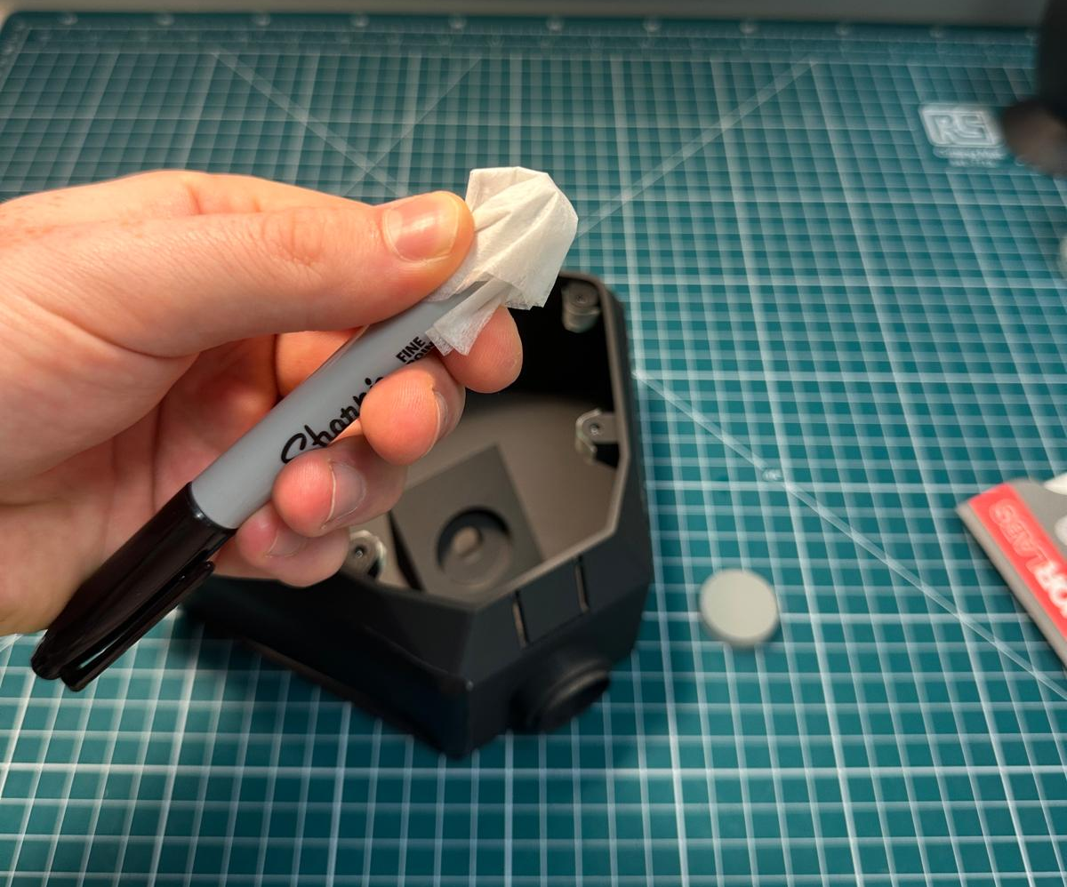
Step 3(c)
TODO:
Next, take a piece of folded lens tissue paper and place it over the end of the sharpie.
By hand (or using gloves) gently place the mirror into its designed slot in the microscope stand. This may take a few attempted to get the correct angle. We designed this with a high tolerance to ensure the mirror does not fall out.

Slide 16
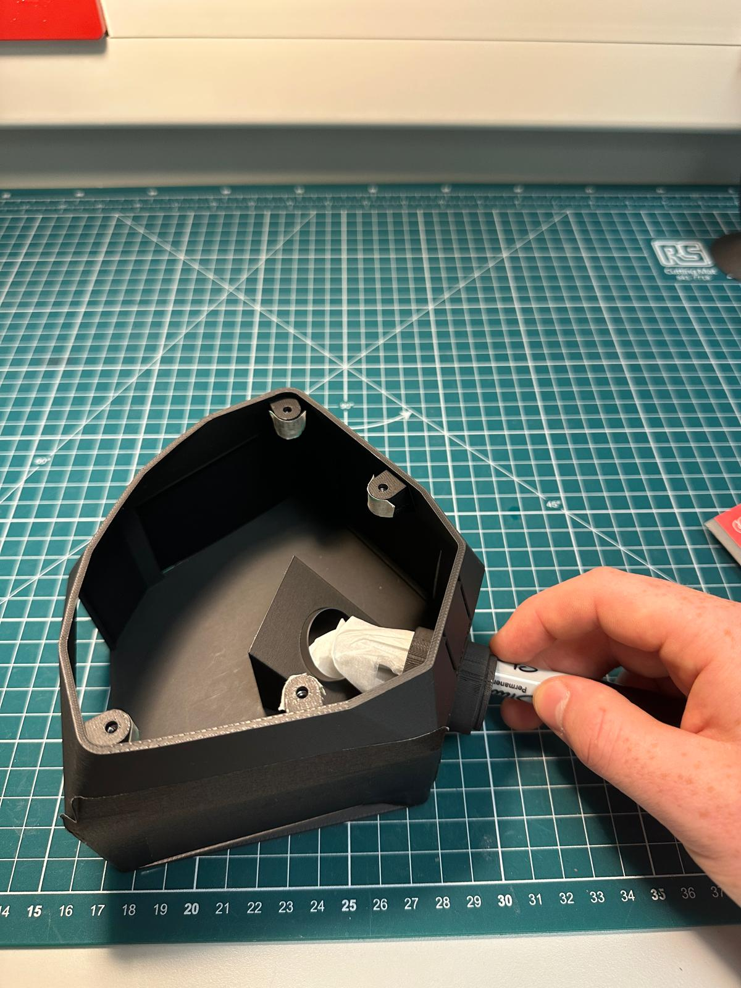
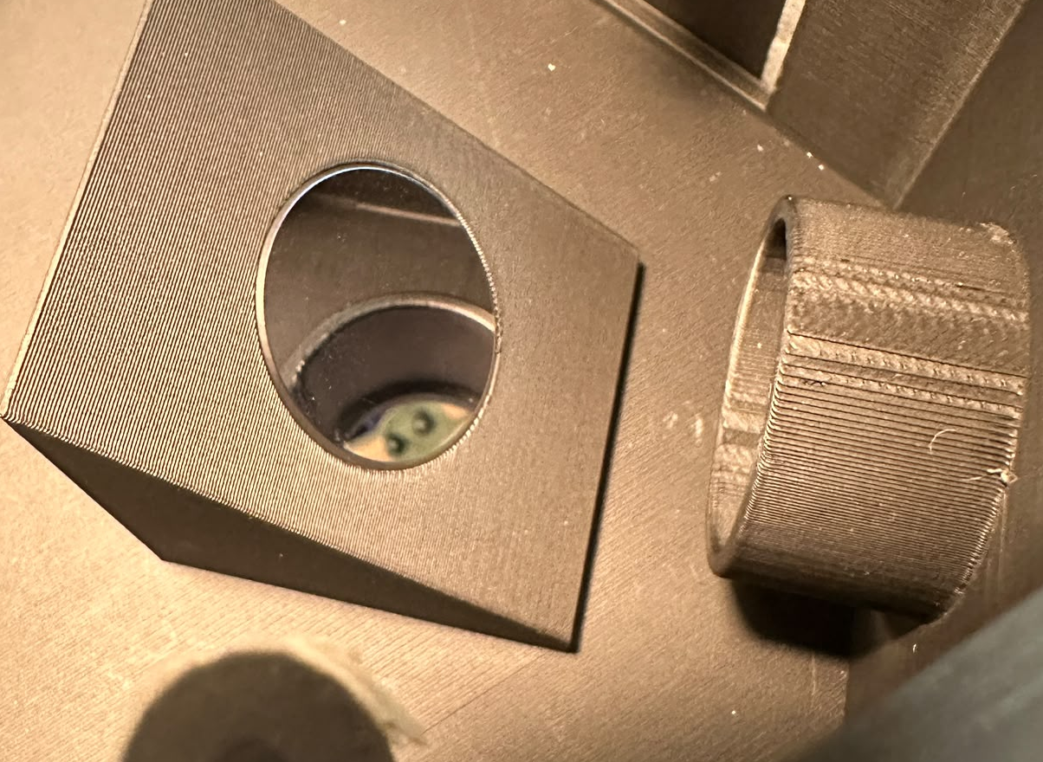
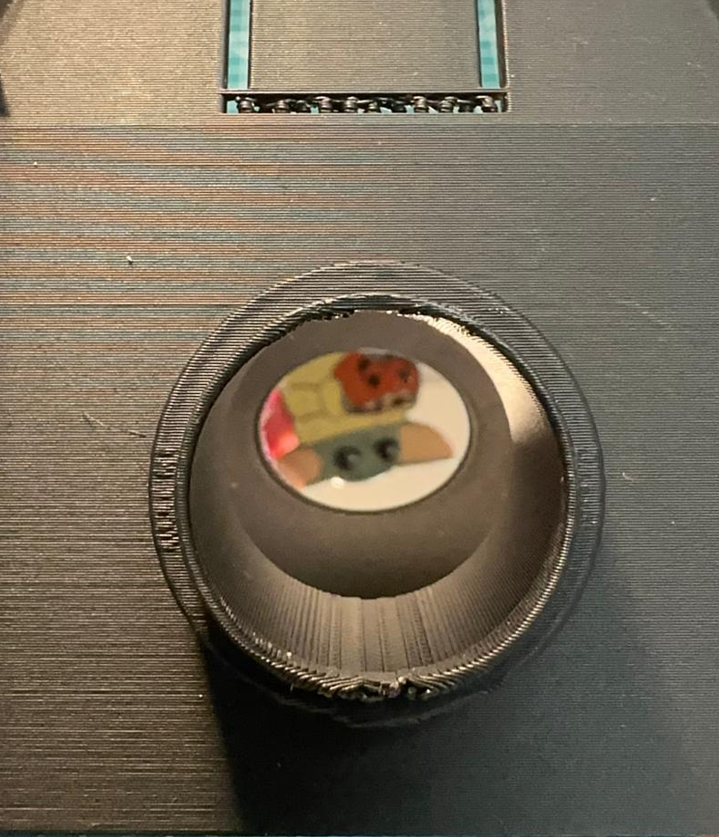
Step 3(c) (cont.)
Top View
TODO:
Once the mirror is fitted, use the tissue covered sharpie to gently push the mirror into the slot until reasonably flush to the surface.
The result should look like the top and front view images.
Front View

Slide 17
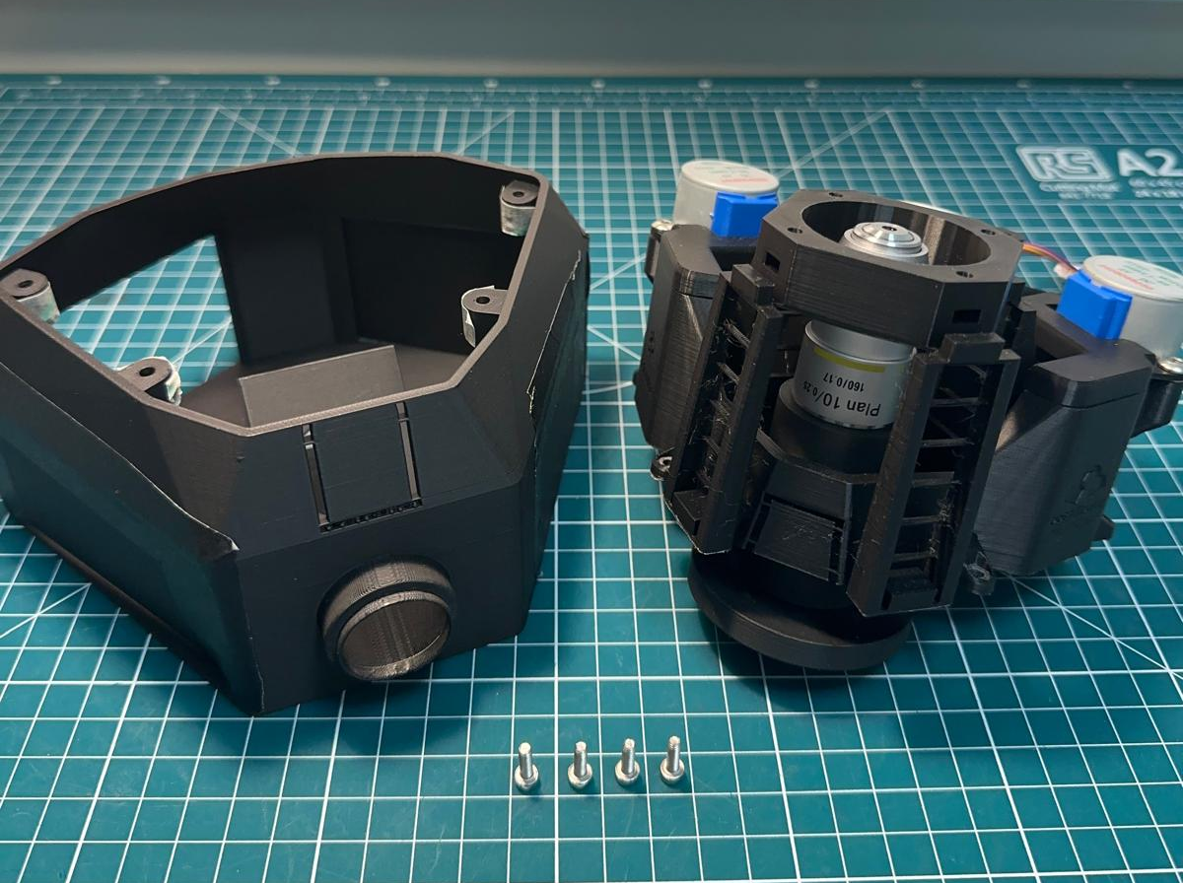
Step 4(a)
What you will need:
OpenFlexure main body and objective lens assembly
OpenFlexure stand with mirror assembly
M3x10mm bolts (x4)

Slide 18
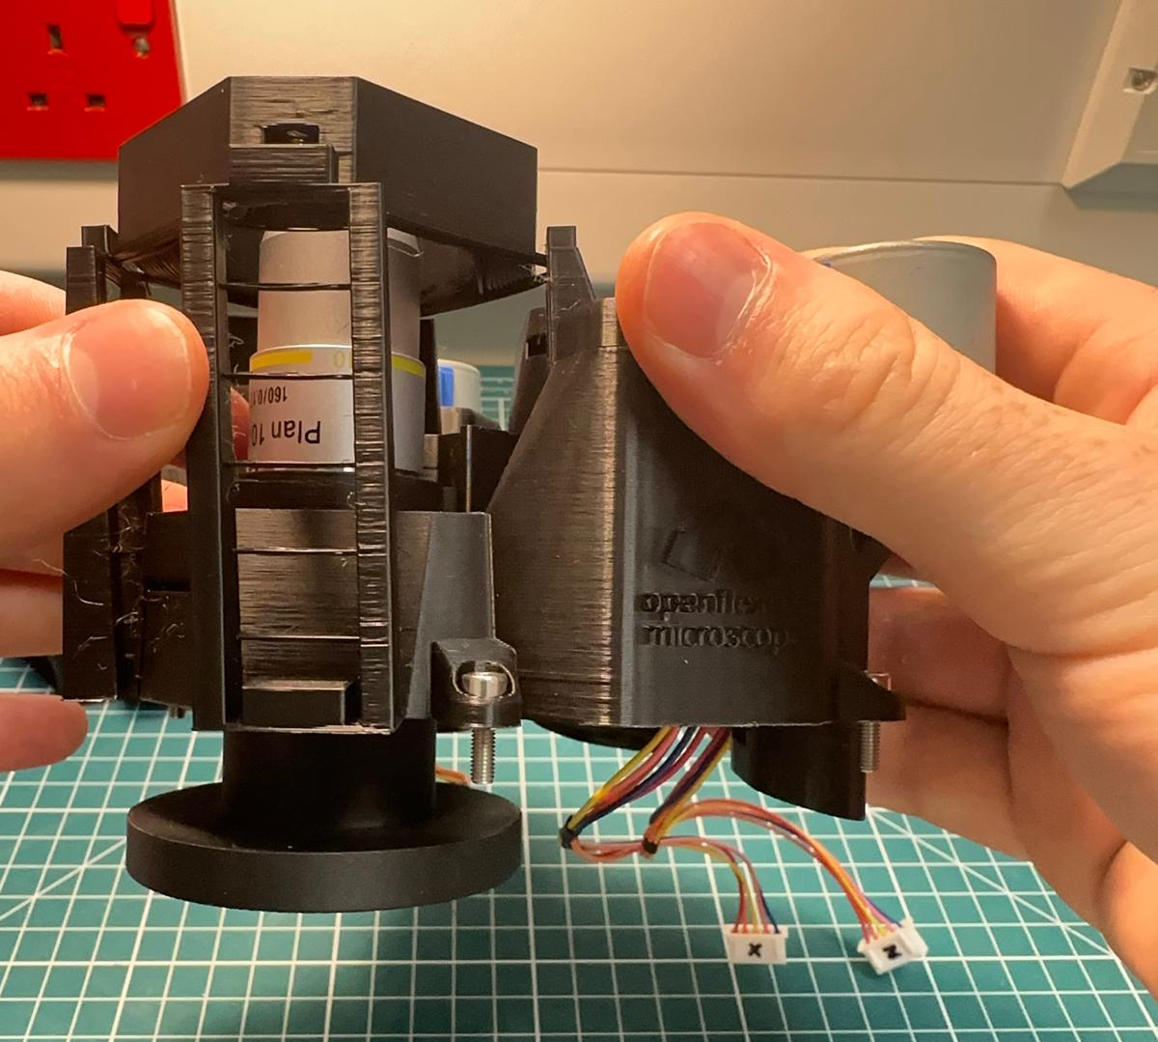
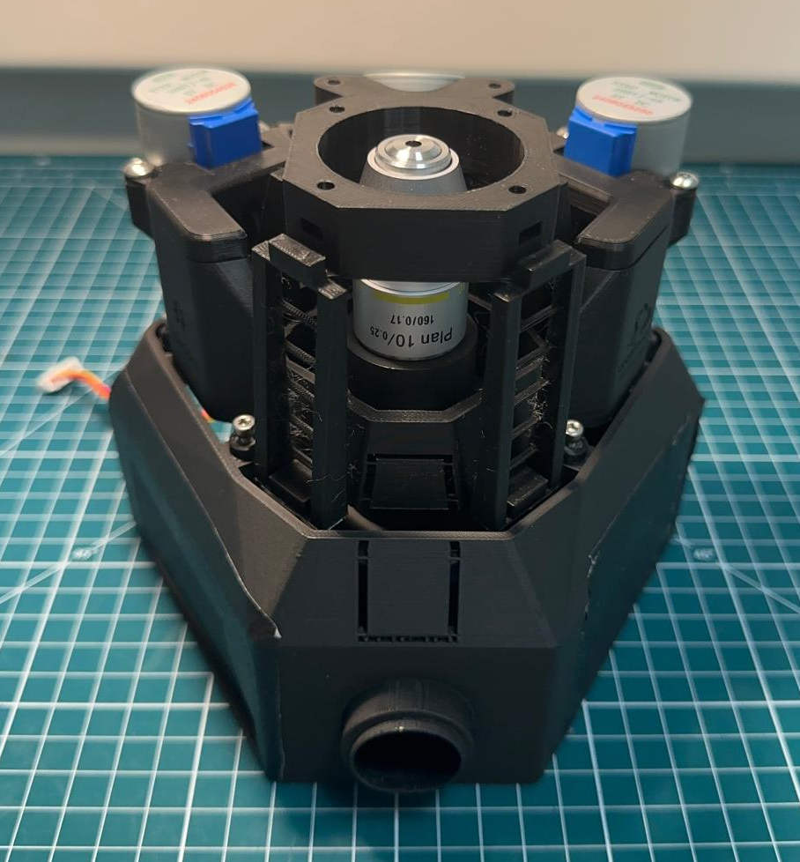
Step 4(b)
TODO:
Similarly to the OpenFlexure notes (Mount the optics and the microscope - Step 2), insert the four M3x10 mm bolts, and then combine the top and bottom assemblies of the microscope.

Slide 19
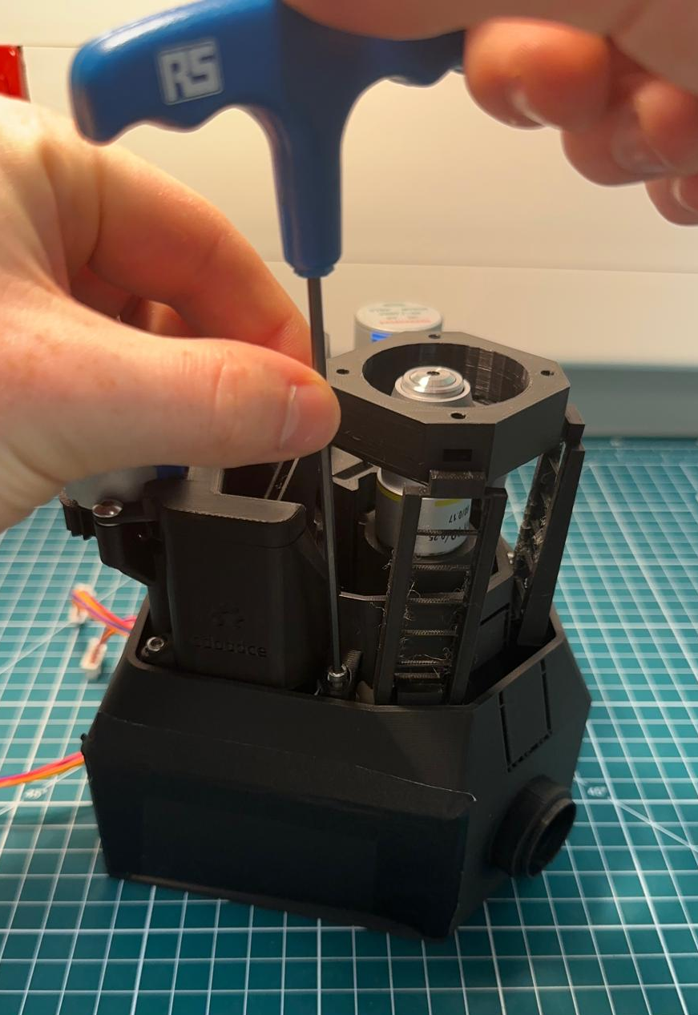
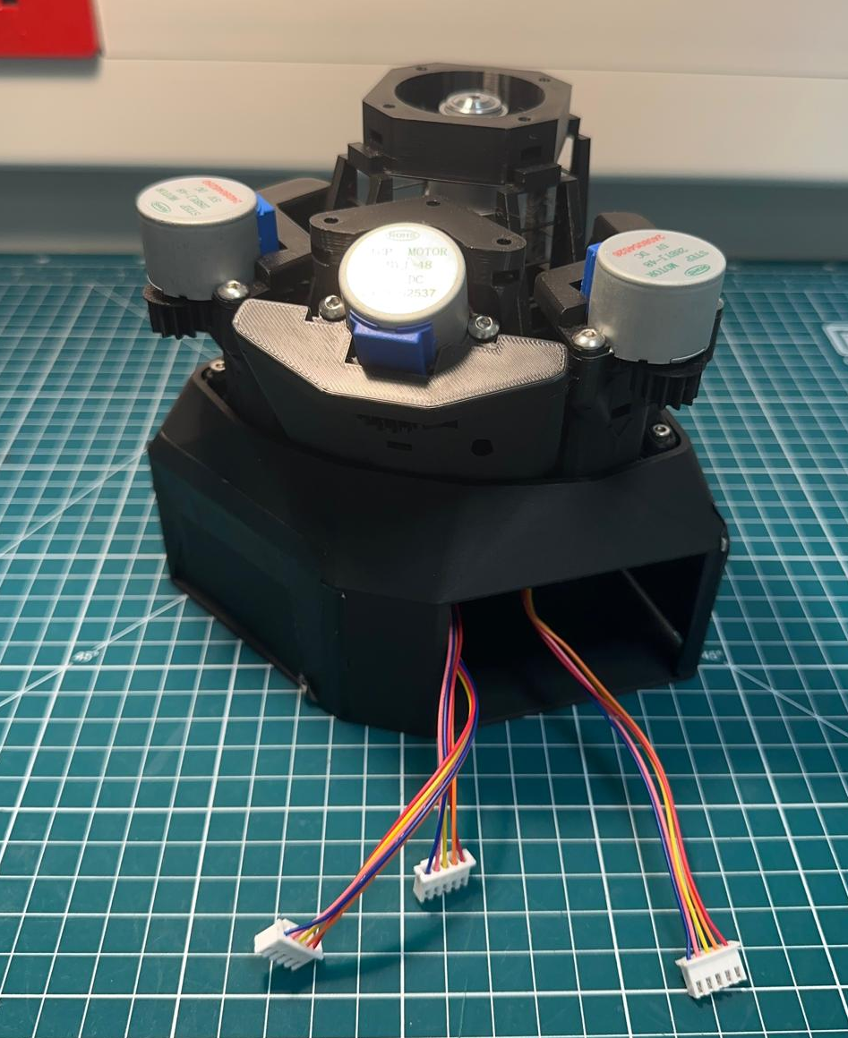
Step 4(c)
TODO:
Tighten the bolts using the 2.5 mm hex key tool.
Both parts of the microscope should now be fully connected, with the motor wires coming out a back window.

Slide 20
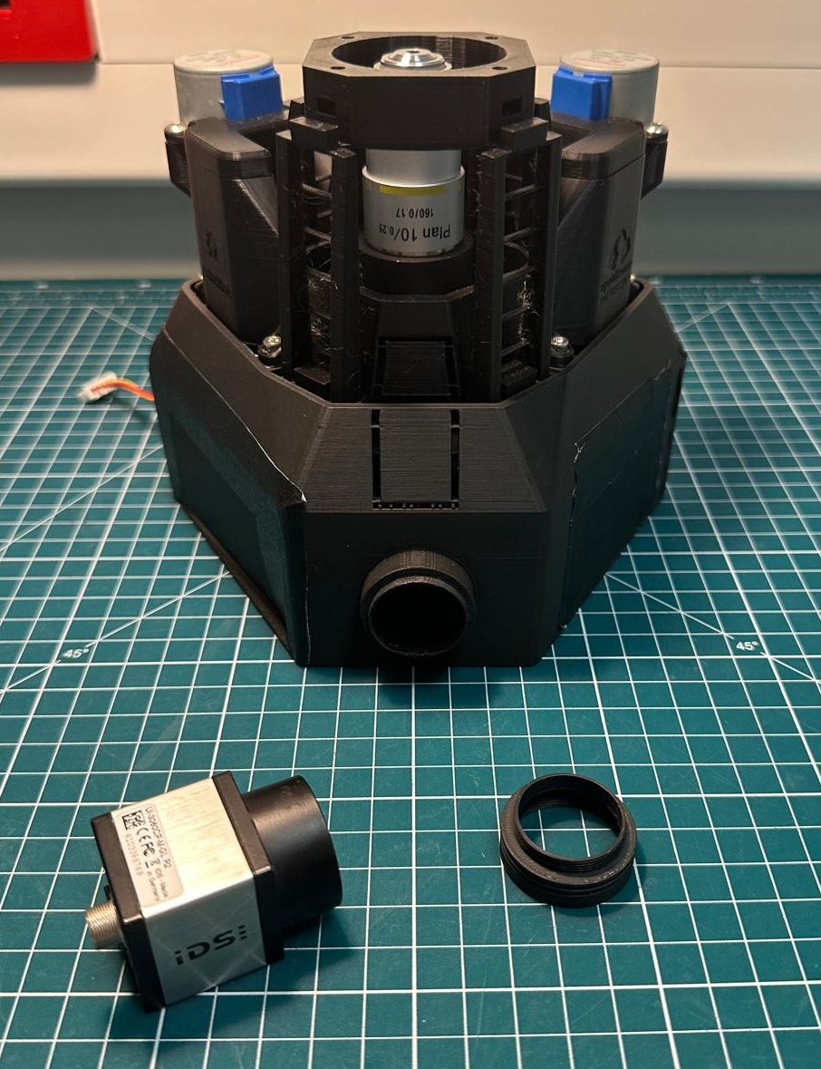
Step 5(a)
This next step demonstrates how to join the camera which will be wired later in the electronics instructions.
What you will need:
Microscope assembly
Camera adapter
C-mount camera

Slide 21
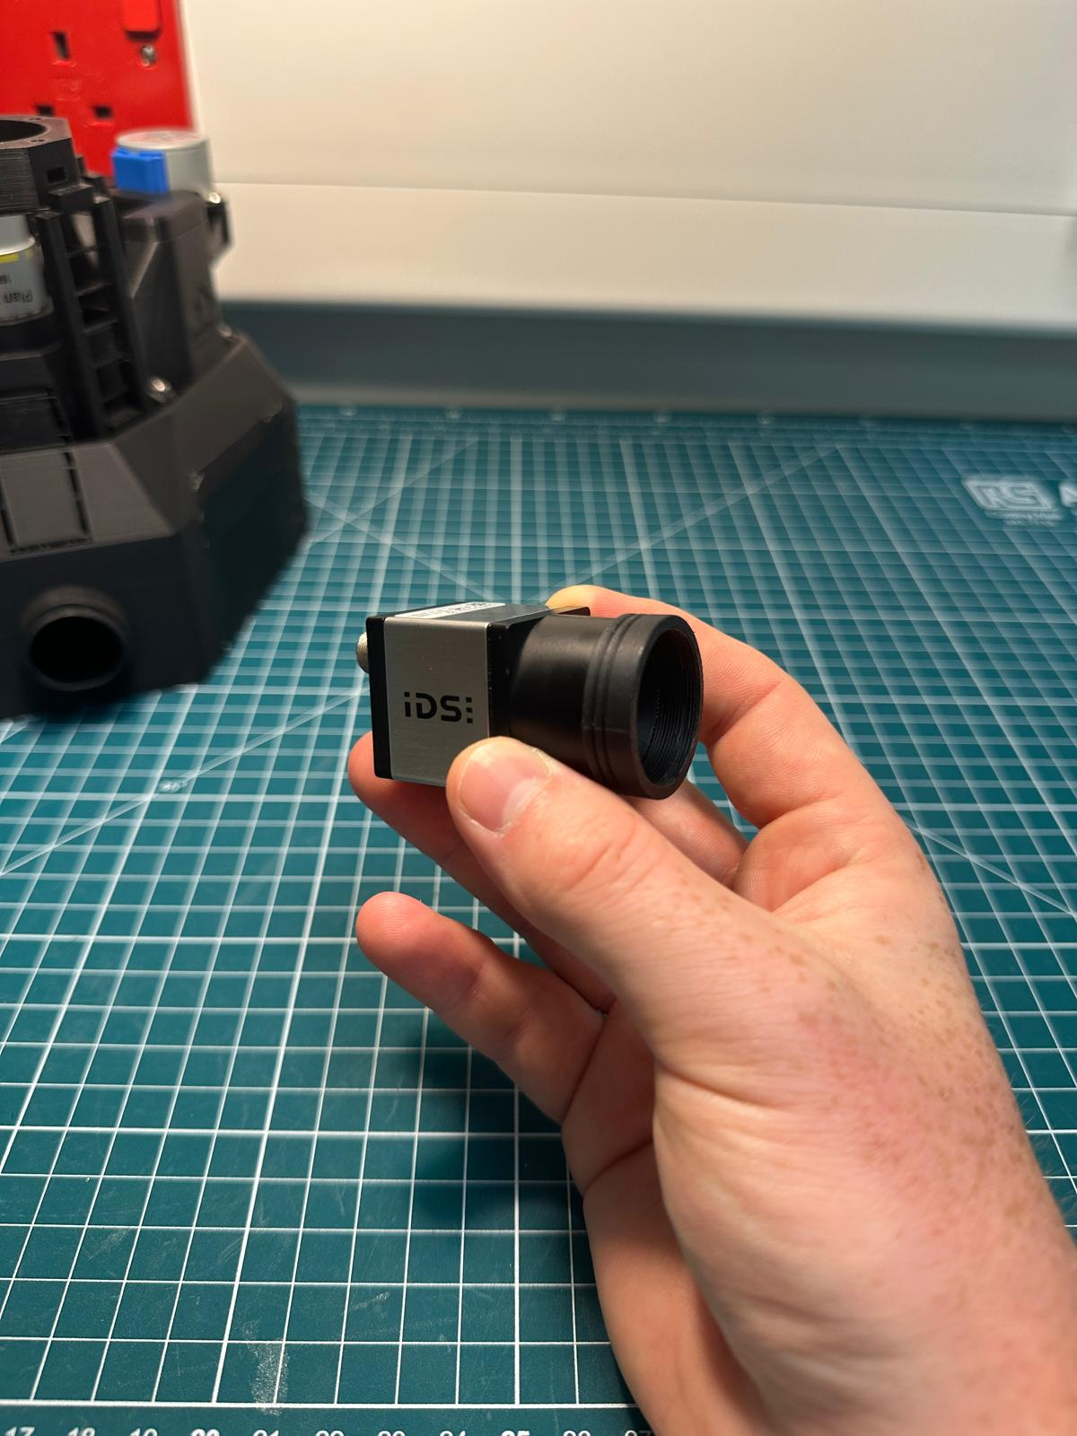
Step 5(b)
TODO:
Connect the threaded camera adapter to the c-mount of the camera as shown in the image.

Slide 22
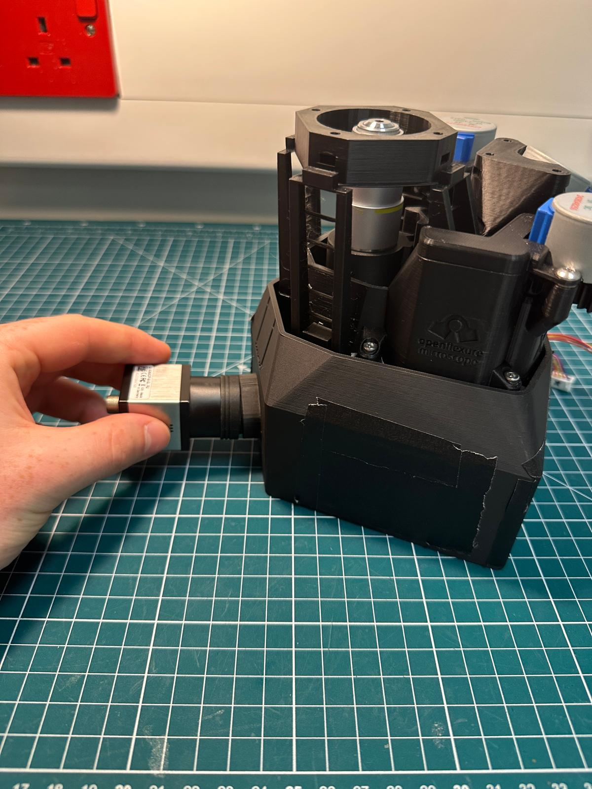
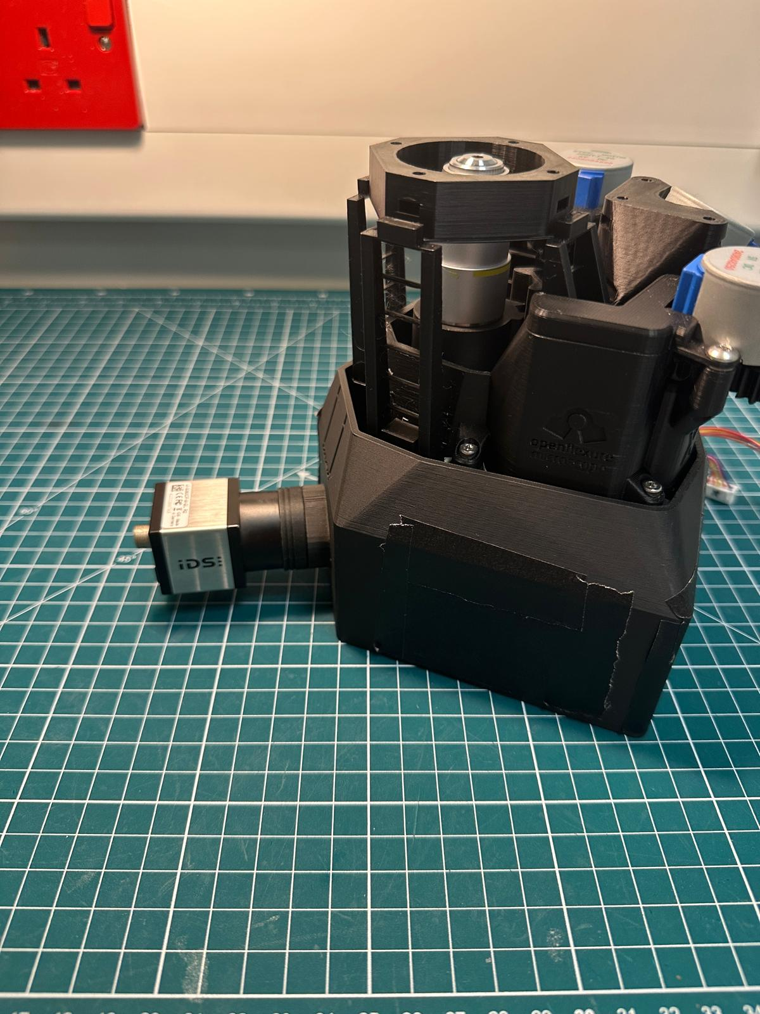
Step 5(c)
TODO:
Next, combine the camera adapter to the front of the microscope assembly as shown.
Ensure that the connection is flush and not tilted as indicated in the red and green box.
Tip:
Depending on the printer settings the threading on the microscope stand may not print off corrected.
In this case the adapter should still connect onto the stand (press it on at an angle until the connection is flush)

Slide 23
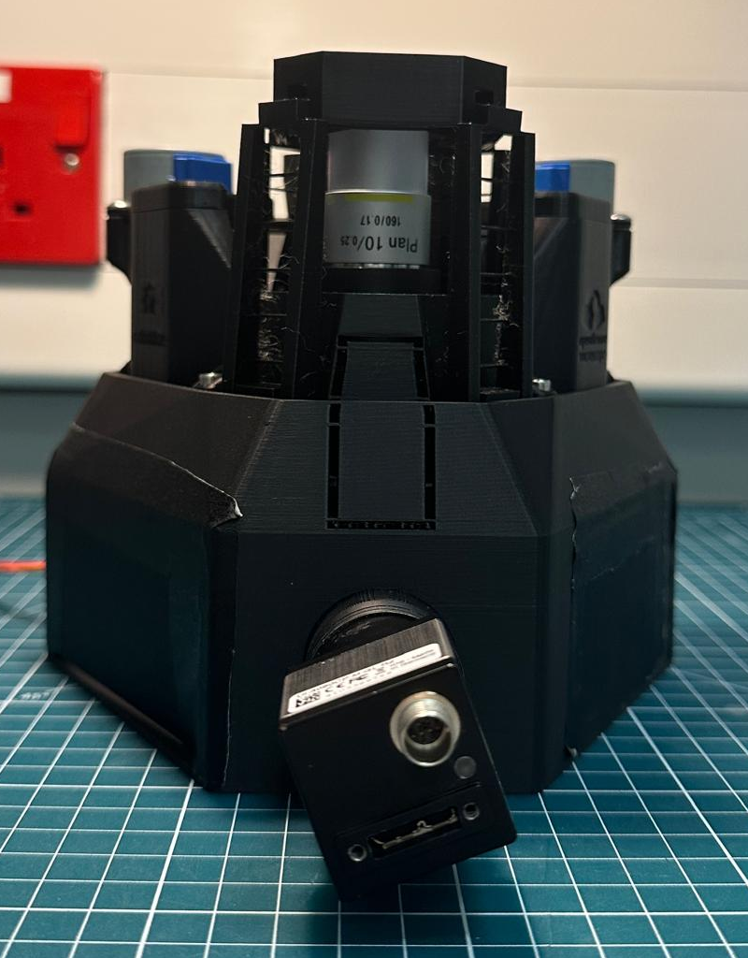
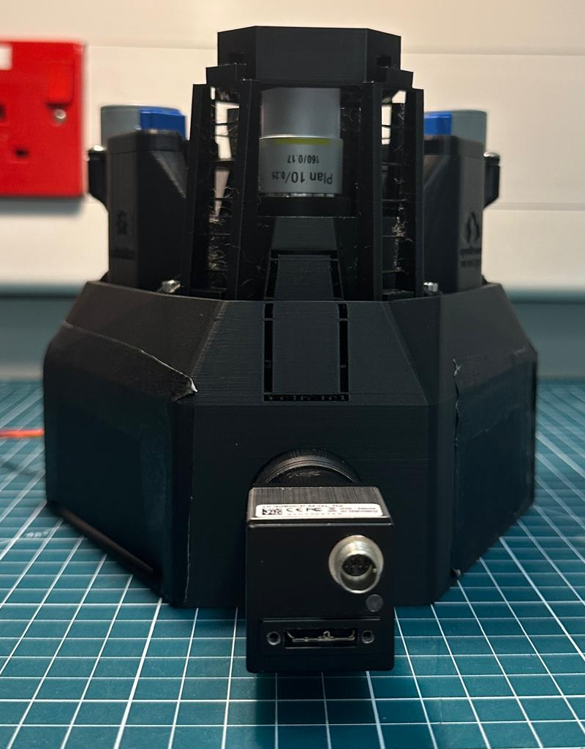
Step 5(d)
TODO:
Finally, ensure your camera is correctly positioned.
As shown in the images, the red box indicates a significantly rotated camera. Alternatively, the green box shows the camera correctly positioned parallel to the surface of the table.
Tip:
Image collection order, LED alignment and calibration are all relative to the camera. Therefore, camera alignment and orientation matters.

Slide 24
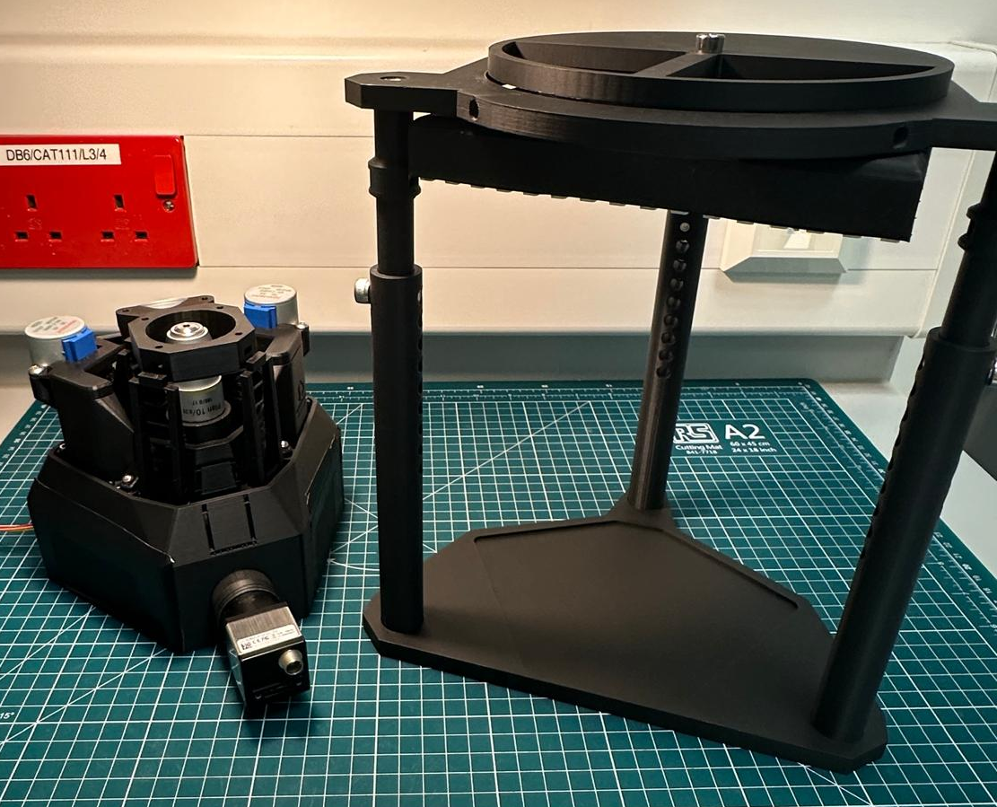
Step 6(a)
What you will need:
Microscope assembly
Illuminator assembly

Slide 25
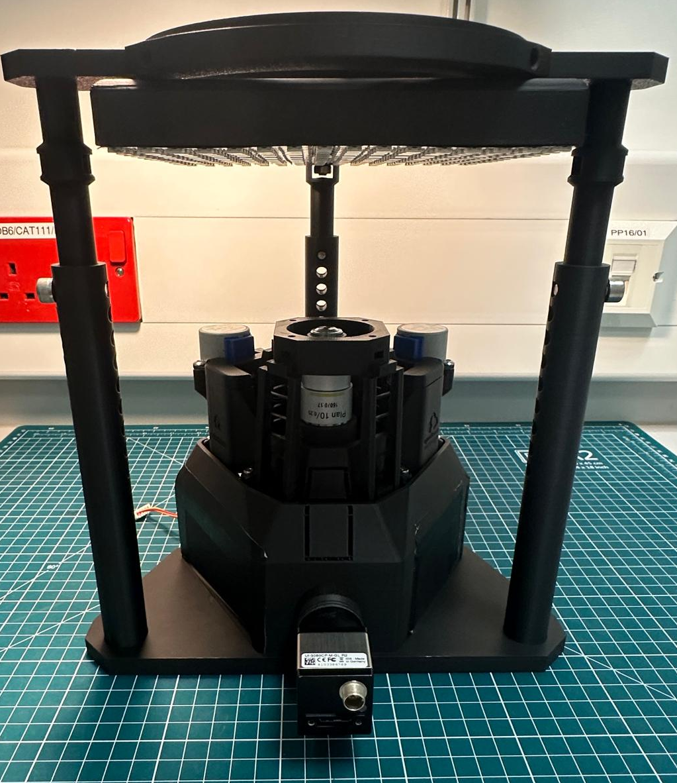
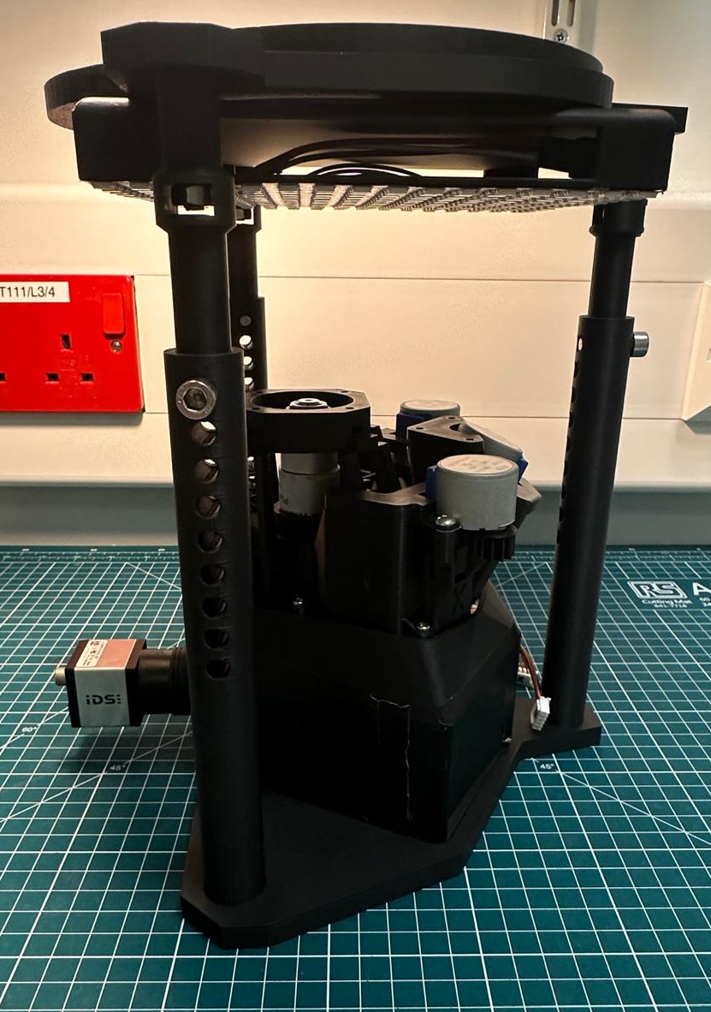
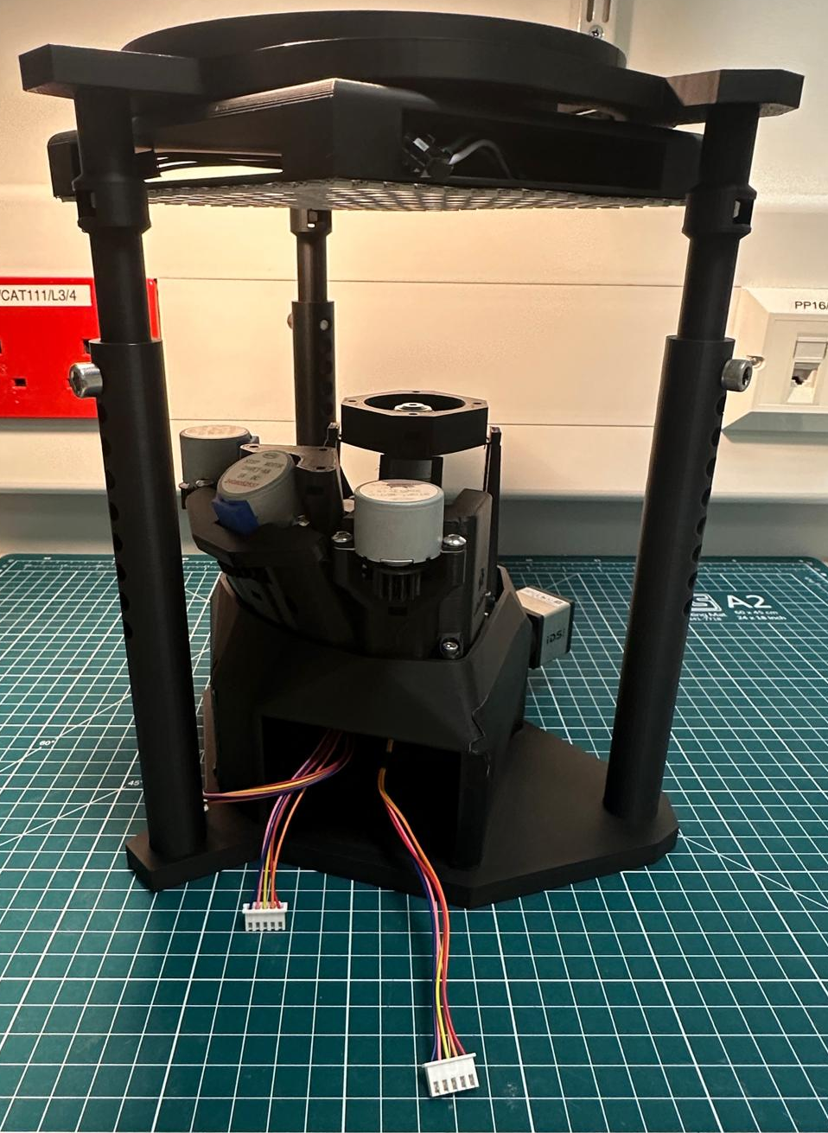
Step 6(b)
TODO:
Insert the microscope assembly into the embedded outline in the illuminator microscope baseplate.
The assembly should resemble the following images:
Next, look at the Electronics Assembly Instructions…

